Slide 1
Business Intelligence G. Mudare

Slide 2
Mining Frequent Itemsets without Candidate Generation

Slide 3
Mining Frequent Itemsets without Candidate Generation
The Apriori candidate generate-and-test method significantly reduces the size of candidate sets, leading to good performance gain
Apriori suffer from two costs:
It may need to generate a huge number of candidate sets.
It may need to repeatedly scan the database and check a large set of candidates by pattern matching.
An interesting method called frequent-pattern growth, adopts a divide-and-conquer strategy

Slide 4
Frequent-pattern growth (FP-Growth
FP-Growth Compresses the database representing frequent items into a frequent-pattern tree, or FP-tree,which retains the itemset association information.
It then divides the compressed database into a set of conditional databases (a special kind of projected database), each associated with one frequent item or “pattern fragment,”
It then mines each sub database separately.

Slide 5
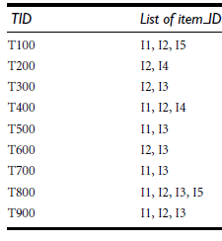
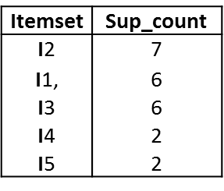
Frequent-pattern growth (FP-Growth) Example
The first scan of the database is the same as Apriori, which derives the set of frequent items (1-itemsets) and their support counts (frequencies).

Slide 6
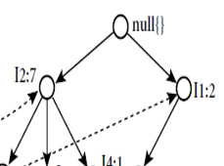

Construct an FP-tree
Create the root of the tree, labelled with “null.”
Scan database D a second time
The items in each transaction are processed in L order (i.e., sorted according to descending support count), and a branch is created for each transaction.

Slide 7
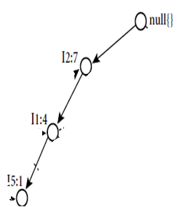
Construct an FP-tree
The scan of the first transaction, “T100: I₁, I₂, I₅,” which contains three items (I₂, I₁, I₅ in L order), leads to the construction of the first branch of the tree with three nodes, I₂: 1, I₁:1, and I₅: 1,

Slide 8
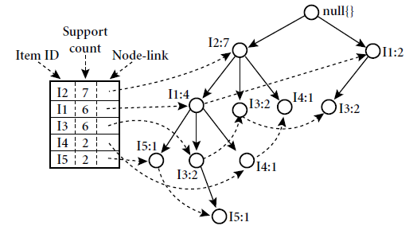
Construct an FP-tree
The scan of the first transaction, “T100: I₁, I₂, I₅,” which contains three items (I₂, I₁, I₅ in L order), leads to the construction of the first branch of the tree with three nodes, I₂: 1, I₁:1, and I₅: 1, where I₂ is linked as a child of the root, I₁ is linked to I₂, and _{I5} is linked to I₁.
The second transaction, T200, contains the items I2 and I4 in L order, which would result in a branch where I2 is linked to the root and I4 is linked to I2.
This branch would share a common prefix, I2, with the existing path for T100.
Increment the count of the I2 node by 1, and create a new node, I4: 1,which is linked as a child of I2: 2.
When considering the branch to be added for a transaction, the count of each node along a common prefix is incremented by 1, and nodes for the items following the prefix are created and linked accordingly
To facilitate tree traversal, an item header table is built so that each item points to its occurrences in the tree via a chain of node-links.
With the associated node-links the problem of mining frequent patterns in databases is transformed to that of mining the FP-tree.

Slide 9
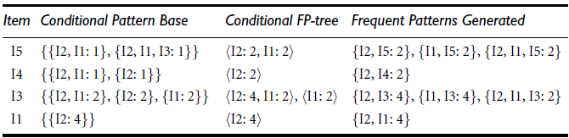
Mining the FP-tree by creating conditional (sub-)pattern bases.
Start from each frequent length-1 pattern (as an initial suffix pattern), construct its conditional pattern base (a “subdatabase,”which consists of the set of prefix paths in the FP-tree co-occurring with the suffix pattern), then construct its (conditional) FP-tree, and perform mining recursively on such a tree.
The pattern growth is achieved by the concatenation of the suffix pattern with the frequent patterns
generated from a conditional FP-tree.

Slide 10
Mining the FP-tree by creating conditional (sub-)pattern bases.
First consider I5, which is the last itemin L, rather than the first.
I5 occurs in two branches of the FP-tree (The occurrences of I5 can easily be found by following its chain of node-links.)
The paths formed by these branches are I2, I1, I5: 1 and I2, I1, I3, I5: 1.
Therefore, considering I5 as a suffix, its corresponding two prefix paths are I2, I1: 1 and I2, I1, I3: 1, which form its conditional pattern base.
Its conditional FP-tree contains only a single path, I2: 2, I1: 2; I3 is not included because its support count is less than the minimum support count.
The single path generates all tof 1he combinations of frequent patterns: I2, I5: 2, I1, I5: 2, I2, I1, I5: 2.
For I4, its two prefix paths form the conditional pattern base, I2, I1: 1, I2: 1, which generates a single-node conditional FP-tree, I2: 2, and derives one frequent

Slide 11
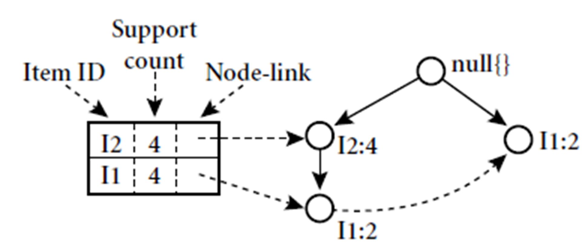
The conditional FP-tree associated with the conditional node I₃.

Slide 12
The conditional FP-tree associated with the conditional node I₃.
The FP-growth method transforms the problem of finding long frequent patterns to searching for shorter ones recursively and then concatenating the suffix.
It uses the least frequent items as a suffix, offering good selectivity. The method substantially reduces the search costs.
When the database is large, it is sometimes unrealistic to construct a main memory based FP-tree.
An interesting alternative is to first partition the database into a set of projected databases, and then construct an FP-tree and mine it in each projected database.
Such a process can be recursively applied to any projected database if its FP-tree still cannot fit in main memory.

Slide 13
Mining Frequent Itemsets Using Vertical Data Format
Both the Apriori and FP-growth methods mine frequent patterns from a set of transactions in TID-itemset format (that is, TID : itemset), where TID is a transaction-id and itemset is the set of items bought in transaction TI
This data format is known as horizontal data format
Data can also be presented in item-TID set format (that is, item : TID setg), where item is an item name, and TID set is the set of transaction identifiers containing the item.
This format is known as vertical data format.

Slide 14
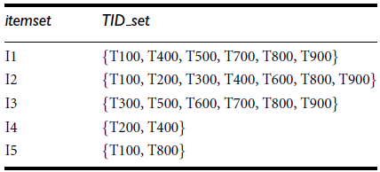
Vertical data format of the transaction data set D

Slide 15
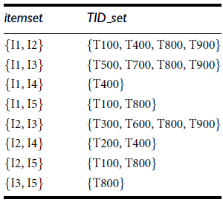
Mining Frequent Itemsets Using Vertical Data Format
Mining can be performed on this data set by intersecting the TID sets of every pair of frequent single items.
Minimum support count is 2
Every single item is frequent in the Table,
10 intersections are performed
in total,which lead to 8 nonempty 2-itemsets

Slide 16
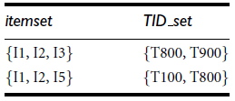
Mining Frequent Itemsets Using Vertical Data Format
Based on the Apriori property, a given 3-itemset is a candidate 3-itemset only if every one of its 2-itemset subsets is frequent.
The candidate generation process here will generate only two 3-itemsets:

